Slide 1

AIFL PROJECT
SETUP AI TEAMS | DRIVE AI DRIVEN CULTURE
©Great Learning. Proprietary content. All Rights Reserved. Unauthorised use or distribution prohibited

Slide 2

DATA SCIENCE ECOSYSTEM
ORGANISATION TYPE
DATA SCIENCE TEAMS
PRODUCT DETAILS
EXECUTION & OPERATIONS
INDEX
©Great Learning. Proprietary content. All Rights Reserved. Unauthorised use or distribution prohibited
Designed by :
KRISHNAV DAVE

Slide 3
1
2
PRODUCT DETAILS
ORGANISATION TYPE
Describe your product here
Describe your organisation here
©Great Learning. Proprietary content. All Rights Reserved. Unauthorised use or distribution prohibited
Designed by :
KRISHNAV DAVE

Slide 4
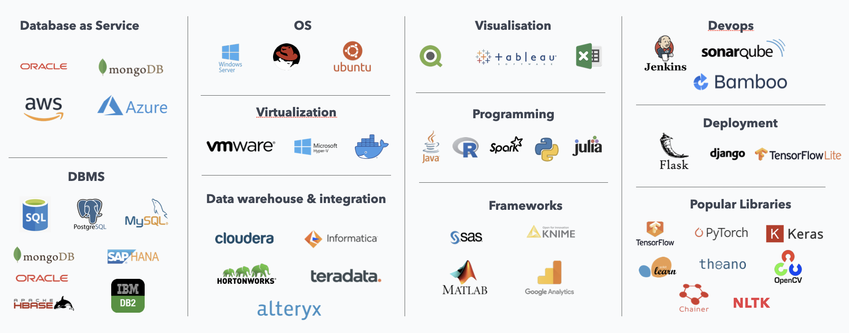
Example
3
DATA SCIENCE ECOSYSTEM
Step 1 - DB: It includes three boxes from above figure i.e. Data as service, DBMS and data warehousing
Step 2 - Development: It includes three boxes from above figure i.e. Programming, Libraries, Frameworks and visualisation
Step 3 - Visualisation: It includes two boxes from above figure i.e. Virtualisation and OS
Step 4 - Deployment: It includes 2 boxes from above figure i.e. Deployment and PLM like devops, Agile, CI-CD etc.
Example of a typical end to end data science ecosystem
©Great Learning. Proprietary content. All Rights Reserved. Unauthorised use or distribution prohibited
Designed by :
KRISHNAV DAVE

Slide 5
Data Planning
Data Base Management
Put your inputs here
Put your inputs here
3
Data Warehousing
AI Model development
DATA SCIENCE ECOSYSTEM
Put your inputs here
Put your inputs here
Describe Organisation’s techno-functional capabilities
AI Product Lifecycle Management
Virtualisation
Put your inputs here
Put your inputs here
©Great Learning. Proprietary content. All Rights Reserved. Unauthorised use or distribution prohibited
Designed by :
KRISHNAV DAVE

Slide 6
Please Note: Add more teams if required
SENIOR MANAGEMENT
CENTRALISED COE
Put your inputs here
SALES TEAM
Put your inputs here
Put your inputs here
4
CHIEF SPONSOR
DATA SCIENCE TEAMS
Put your inputs here
FUNCTIONAL SME
DATA SCIENCE SME
IT/DEPLOYMENT SME
Put your inputs here
Put your inputs here
Put your inputs here
©Great Learning. Proprietary content. All Rights Reserved. Unauthorised use or distribution prohibited
Designed by :
KRISHNAV DAVE

Slide 7
Please Note: Add more teams if required
CENTRALISED COE
INFRA SUPPORT
Put your inputs here
Put your inputs here
4
DATA SCIENCE SME
DATA SCIENCE TEAMS
Put your inputs here
DATA SME
MODEL DESIGN SME
MODEL TEST SME
Put your inputs here
Put your inputs here
Put your inputs here
©Great Learning. Proprietary content. All Rights Reserved. Unauthorised use or distribution prohibited
Designed by :
KRISHNAV DAVE

Slide 8
5
EXECUTION & OPERATIONS
List down all steps specific to roles to enable to product from design to deployment phase
End to end product lifecycle management structure and procedure
©Great Learning. Proprietary content. All Rights Reserved. Unauthorised use or distribution prohibited
Designed by :
KRISHNAV DAVE

Slide 9
AIFL PROJECT
SETUP AI TEAMS | DRIVE AI DRIVEN CULTURE
©Great Learning. Proprietary content. All Rights Reserved. Unauthorised use or distribution prohibited

